Slide 1
Real Time communications

Slide 2
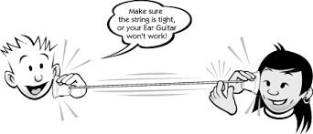
Definitions
What is Real Time communications ?
Communication where the information is delivered to the other side without any delay or with a delay that cannot be experienced by the user.

Slide 3
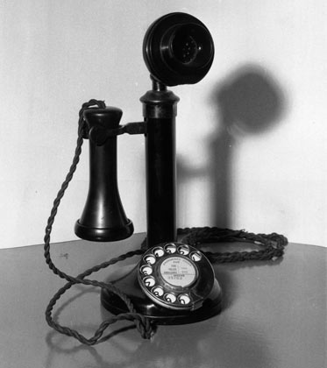
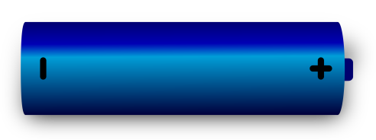
One of the major application of Electronics was in Real time communication
Microphone
Headset
Simple Circuit Switched Telephony could provide reliable Real time Communication
But it came with its own limitations

Slide 4
Pros and cons of Circuit Switched
Pros | Cons
The major advantage of circuit switching is that it has a predictable performance that can be guaranteed. Once the circuit has been established, the communication is typically error-free and relatively fast. | The disadvantage of circuit switching is that it requires an initial channel set up that is usually time-consuming
Easy to implement | Needs a dedicated “Connection” between the two points, which gets under utilized when not used.
 | During failure, it is not possible to establish alternative routes. Frequency of failures and down time is very high

Slide 5
Evolution of Packet switching
Packet switching is a digital networking communications method that groups all transmitted data into suitably sized blocks, called packets, which are transmitted via a medium like copper wire or RF signals .
Since the fault tolerance of Circuit Switched network was very poor, as solution 1950s, American computer scientist Paul Baran developed the concept Distributed Adaptive Message Block Switching which provided a much better fault tolerant system
In a packet switched network, data is transmitted in the form of packet with a “From” and “To” Address, just like a Postal Letter. Such mechanism ensured that a channel is occupied , only during the transmission of the packet, and upon completion of the transmission the channel is made available for the transfer of other traffic[]
Fault Tolerance was given such a importance, so that a packet switched network could withstand a Nuclear Attack

Slide 6
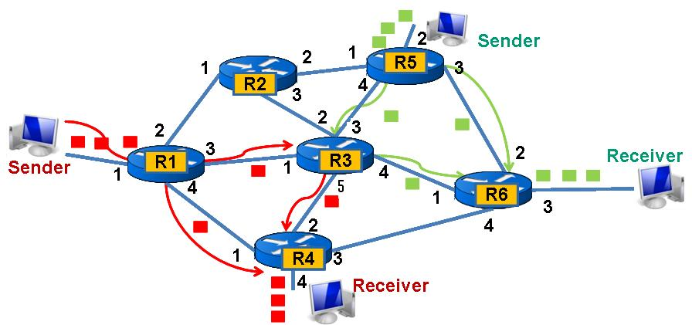

Slide 7
Disadvantage of Packet switched network
The biggest disadvantage of packet switching, is that information is transmitted as discrete blocks rather than in a continuous stream. This makes data arrive in bundles at the destination.
Then the that must be reassembled at the reception point.
Packets are routed through different types of network devices like routers and switches, and make take different routes.
So the packets can arrive at their destination out of their original sequence.

Slide 8
Advantages of Packet switching
Efficient use of Network with better utilization
Easily get around broken bits or packets.
Packet switching can support high data transmission rates
All the packets not follow same route in Packet Switching, this enables fault tolerance

Slide 9
Types of Packet switched networks
Packet Switched
Connection Oriented (Virtual Circuit)
Connection less or (datagram)
TCP
X.25
Frame Relay
Multiprotocol Label Switching
IP
UDP
Ethernet

Slide 10
Types of Packet Switched network
Connection Less Mode : Each packet will have the complete addressing information. Each packet is routed individually, this will result in different paths and out-of-order delivery. Each packet will have
Destination address
Source address
Port numbers
Connection-oriented For a setup phase is included in each involved node before any packet is transmitted to establish the parameters of communication. The packets include a connection identifier rather than address information and are negotiated between endpoints so that they are delivered in order and with error checking.
Unlike Connection less, address information is only transferred to each node during the connection set-up phase, when the route to the destination is discovered and an entry is added to the switching table in each network node through which the connection passes.

Slide 11
How it is implemented
Your application server.c or client.c
Application Layer
Application Layer
Presentation Layer
Socket Interface
fd = socket(……)
Session Layer
Transport Layer
TCP or UDP
Network Layer
IP Layer
Data Link Layer
Ethernet Layer
Ethernet Drivers and Card
Physical Layer
Physical Layer
Cables

Slide 12
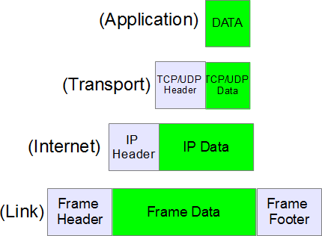
Application Layer
TCP or UDP
IP Layer
Ethernet Layer
Physical Layer

Slide 13
How does the big picture look like
Unlike in circuit switched network, packets take different routes and pass through different network elements like switches and routers etc. This introduce lot of challenges in the data path during an end to end communication. These challenges appears in two forms
From the System point of view
From the User’s point of view
For a user it appears as the experience this is what is call as “User Experience” – It appears to user in the form of delay, or in the variations of delay called as Jitter, green patches seen on the monitor when some packets are lost or arrived too late.
For the system, it all about delivering the user experience with minimum usage of resources like memory, CPU etc. Though most of the data for video calls or audio calls are periodic in nature there will asynchronous data which comes in the form of a-periodic messages or sporadic message, system should be able to handle them with minimum resource. This exactly where different scheduling methods comes into picture.

Slide 14
Some Key Terms used in RT Communications
Term | Explanation
Delay | End to end delay during video call. ( End of end delay during video streaming of a lecture
Buffer | (ii) When a packet arrives early it has to be buffered till the others in sequence arrives (ii) we maintain a buffer of packets to smooth playback during streaming
Throughput | Rate of arrival of messages per sec
Jitter | Variation of delay experienced by different packets of a interactive application

Slide 15
Difference between TCP and UDP
No | TCP | UDP
Relaiabity | TCP is connection-oriented protocol. When a file or message send it will get delivered unless connections fails. If connection lost, the server will request the lost part. There is no corruption while transferring a message. | UDP is connectionless protocol. When you a send a data or message, you don’t know if it’ll get there, it could get lost on the way. There may be corruption while transferring a message.
Ordered | If you send two messages along a connection, one after the other, you know the first message will get there first. You don’t have to worry about data arriving in the wrong order. | If you send two messages out, you don’t know what order they’ll arrive. Order is not guaranteed
Resource Requirements | when the low level parts of the TCP “stream” arrive in the wrong order, resend requests have to be sent, and all the out of sequence parts have to be put back together, this required more CPU and resources hence called heavy weight | No ordering of messages, no tracking connections, etc. It’s just fire and forget! This means it’s a lot quicker, and the network card / OS have to do very little work to translate the data back from the packets. Hence called light weight
Nature Of Data | Streaming Data is read as a “stream,” with nothing distinguishing where one packet ends and another begins. There may be multiple packets per read call. | Datagrams: Packets are sent individually and are guaranteed to be whole if they arrive. One packet per one read call.
Uses | WWW, Email, FTP, SSH, Signaling | Streaming media, online games

Slide 16
Quality of Service
Quality of service (QoS) is the overall performance of a telephony or computer network, particularly the performance seen by the users of the network.
No | Parameter | Explanation
1 | Throughput | Amount of Data transmitted
2 | Dropped packets | The routers might fail to deliver (drop) some packets if their data loads are corrupted, or the packets arrive when the router buffers are already full.
3 | Errors | Sometimes packets are corrupted due to bit errors caused by noise and interference, especially in wireless communications and long copper wires. The receiver has to detect this and, just as if the packet was dropped
4 | Latency | It might take a long time for each packet to reach its destination, because it gets held up in long queues,
5 | Jitter | Packets from the source will reach the destination with different delays
6 | Out of Order Delivery | When a collection of related packets is routed through a network, different packets may take different routes, each resulting in a different delay

Slide 17
How is QoS parameters used for real time communications
For any real time communications (Like VOIP, Video conferencing) the QoS Parameters has to maintained at certain level. Otherwise the user experience will be significantly impacted.
Hence it is good practice to check whether network can deliver the required QoS parameters before connection. This method is called Admission Control
So in modern communications whether is real time or not, the program which request for a connection to remote server will first declares the QoS Parameters it needs for a smooth operation. The Admission Control Server which is located some where in the network will inspect the QoS Parameters needed and reserves the network resources in a chosen route. Before it reserves the parameters across each network element it will do an “acceptance test” to see whether such a connection can be established with out disturbing the existing connection. If that is case the connection is accepted else it is rejected – This is what exactly happens in case of VOIP call in real network

Slide 18
Question ? Why do the Qos Parameters changes in a network ?

Slide 19
Case study of Admission control on Cisco VOIP/TP call system and skype
For IP-based applications such as telephony, video, and application sharing, the available bandwidth of enterprise networks is NOT generally considered to be a limiting factor within LAN environments. However, on WAN links that interconnect offices, network bandwidth can be limited.
Call admission control (CAC) determines whether there is sufficient network bandwidth to establish a real-time session of acceptable quality. CAC controls real-time traffic only for audio and video does not affect data traffic

Slide 20
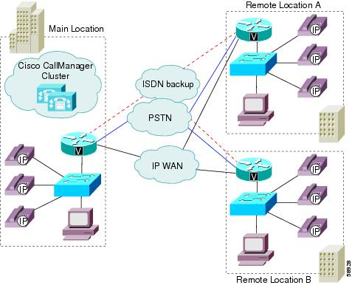
Cisco Implementation
Cisco Implemented CAC to control the audio quality and video quality of calls over a wide-area (IP WAN) link by limiting the number of calls that are allowed on that link at the same time. For example, you can use call admission control to regulate the voice quality on a 56-kbps frame relay line that connects your main campus and a remote site. In this implementation CAC does not guarantee a particular level of audio or video quality on the link, but it does allow you to regulate the amount of bandwidth that active calls on the link consume.
.
Calls between devices at the same location do not need call admission control because those devices reside on the same LAN, which has unlimited available bandwidth. However, calls between devices at different locations must travel over an IP WAN link, which has limited available bandwidth

Slide 21
Skype for Business
For every office (region) , there is only one Bandwidth Policy Service per network region, which manages bandwidth policy for that region, its associated sites and the links to those sites. The Bandwidth Policy Service runs as part of the Front End Servers, and therefore high availability is built-in within that pool.
Call admission control (CAC) determines whether there is sufficient network bandwidth to establish a real-time session of acceptable quality. In Skype for Business Server, CAC controls real-time traffic only for audio and video, but it does not affect data traffic. If the default WAN path does not have the required bandwidth, CAC can attempt to route the call through an Internet path or the public switched telephone network (PSTN).
Skype which runs on your laptop does not do CAC, as it is not possible to do CAC on the internet. CAC is possible only within Intranet WANs.

Slide 22
Bandwidth utilization by codecs
Codec | Bandwidth requirement with no forward error correction (FEC) | Bandwidth requirement with forward error correction (FEC)
RTAudio (8kHz) | 49.8 kbps | 61.6 kbps
RTAudio (16kHz) | 67 kbps | 96 kbps
Siren | 57.6 kbps | 73.6 kbps
G.711 | 102 kbps | 166 kbps
G.722 | 105.6 kbps | 169.6 kbps
RTVideo (CIF 15 fps) | 260 kbps | Not applicable
RTVideo (VGA 30 fps) | 610 kbps | Not applicable

Slide 23
How do we address the problems in packet switched networks How do we do real time communications over a packet switched network

Slide 24
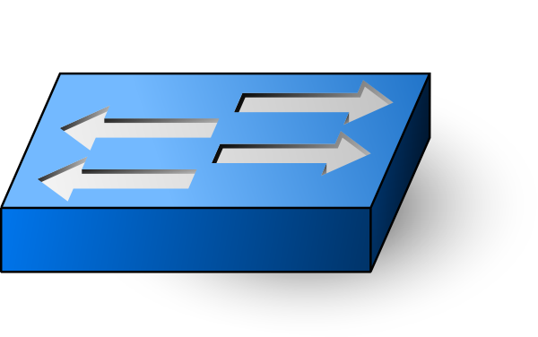
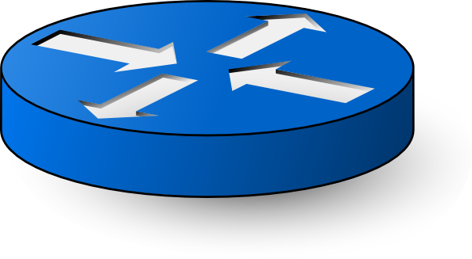
Switch
Router

Slide 25

A typical network

Slide 26
Switches and Routers
All Switches do some amount of buffering of packets they handle, or the maintain a queue of the packets that needs to be transmitted. This causes a finite amount of delay, with this development of new hardware this delay is dropping significantly, and resulting in faster network.
Every network element will introduce some element of delay to each packet this is called the per hop delay. This per-hope delay is caused mainly of packets queued up in the switch or router. Once a packet is ready for transmission it is queued, and wait for scheduler to schedule it from transmission. The scheduler algorithm which schedules the packets for transmission plays a critical role in the per-hop-delay.
Total end to end Delay will be sum total of per-hop-delays introduced by each network element.
Question: How does packets get queued up in the router ?

Slide 27
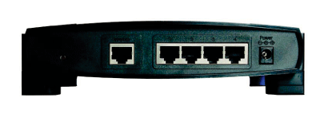
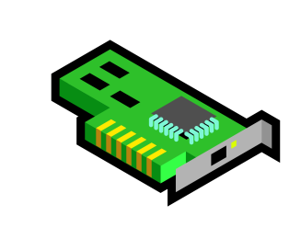
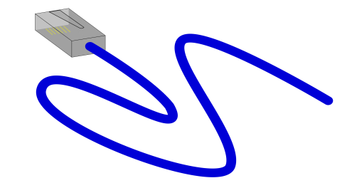

A Router with a Ethernet interface Router acts like an intersection in the highway with signboards
162.129.XXX.XXX
Default Gateway
162.140.XXX.XXX
162.110.XXX.XXX

Slide 28
Weighted Fair Queuing
In the diagram we have four physical network interfaces:
Default gateway
N/W interface to send packets to network 162.129.XXX.XXX
N/W interface to send packets to network 162.140.XXX.XXX
N/W interface to send packets to network 162.110.XXX.XXX
Take an example interface ,say 162.140.XXX.XXX there will be VoIP phones in the network which needs real time response , FTP sessions, telnet session, email session etc. Now of all packets gets queued up in a FIFO manner at the network interface of 162.140.XXX.XXX there will be lot of congestion and it will deliver a poor user experience for VoIP users. FIFO is not an effective mechanism here.
So there has to be some mechanism to identify packets which needs priority (Eg: VoIP traffic) and push them to the front of the queue to reduce response time and fairly shares the remaining bandwidth among the other bandwidth flows.
That means we need to allocate the bandwidth fairly at the network interface so that every connection will get a fair amount of bandwidth. Weighted Fair Queuing is one such algorithm used in Routers to handle this condition.

Slide 29
Weighted Fair Queueing
WFQ is a dynamic scheduling method that provides fair bandwidth allocation to all network traffic.
IT does this by applies priority, or weights, to identified traffic to classify traffic into conversations and determine how much bandwidth each conversation is allowed relative to other conversations.
WFQ is a flow-based algorithm that simultaneously schedules interactive traffic to the front of a queue to reduce response time fairly shares the remaining bandwidth among high-bandwidth flows. WFQ allows to give low-volume traffic, such as Telnet sessions, priority over high-volume traffic, such as FTP sessions.
WFQ gives concurrent file transfers balanced use of link capacity; that is, when multiple file transfers occur, the transfers are given comparable bandwidth.

Slide 30
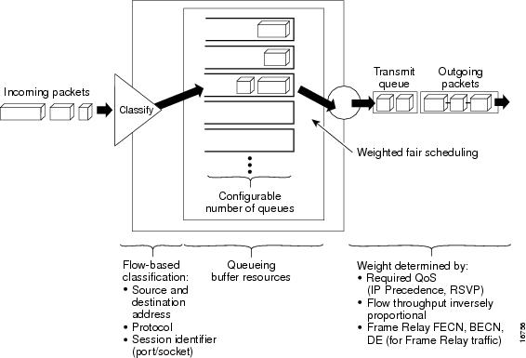

Slide 31
WFQ provides traffic priority management that dynamically sorts traffic into messages that make up a conversation.
Algorithm classifies the train of packets within a conversation to ensure that bandwidth is shared fairly between individual conversations and that low-volume traffic is transferred in a timely fashion. How does the algorithm break up the train ?
Algorithm classifies traffic into different flows based on
Packet header address
Source and destination address
MAC address,
Protocol, source and destination port
Socket numbers of the session,

Slide 32
In this process traffic will be categorized into two types roughly
High bandwidth sessions
Low bandwidth sessions.
Low-bandwidth traffic streams, which comprise the majority of traffic, receive preferential service based on weights, allowing their entire offered loads to be sent in a timely fashion.
High-volume traffic streams share the remaining capacity proportionally among themselves.
WFQ places packets of the various conversations in the fair queues before transmission. The order of removal from the fair queues is determined by the virtual time of the delivery of the last bit of each arriving packet.

Slide 33
Fair Queue management
However the Fair Queue has a limitation to its queue length , the queue may get full
When the queue gets full
For high bandwidth traffic the packets are discarded (How does system handles it)
For Low bandwidth traffic which carry control message are queued by dynamically increasing the queue size (as a special case as we cannot drop control messages)
WFQ can manage
data streams such as voice or video.
addresses the problem of round-trip delay variability.

Slide 34
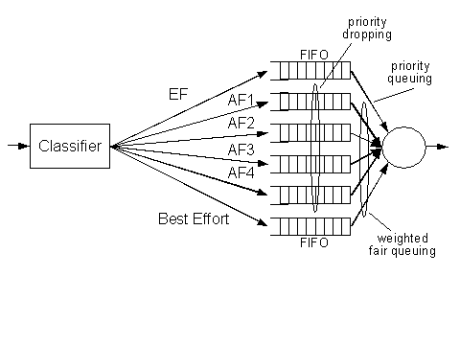

Slide 36
Restrictions with WFQ
WFQ is not supported with tunneling and encryption because these features modify the packet content information required by WFQ for classification.

Slide 37
WFQ is IP precedence-aware
It can detect higher priority packets marked with precedence by the IP Forwarder and can schedule them faster, providing superior response time for this traffic. Thus, as the precedence increases, WFQ allocates more bandwidth to the conversation during periods of congestion.
WFQ assigns a weight to each flow, which determines the transmit order for queued packets. In this scheme, lower weights are served first. For standard Cisco IOS WFQ, the IP precedence serves as a divisor to this weighting factor.

Slide 38
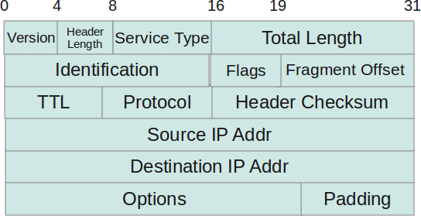
How is it done in IP Datagram
Type of service(8 bits) : The first three bits of this field are known as precedence bits The next 4 bits represent type of service and the last bit is left unused. The 4 bits that represent TOS are : minimize delay, maximize throughput, maximize reliability and minimize monetary cost.

